Slide 1

Interviewing for a DBA job
Steve Peterson Sr Data Engineer 1800 CONTACTS INC

Slide 2





Thank you to our Global Sponsors and Supporters

Slide 3

We are thrilled to say the first ever PASS Virtual Summit will be taking place this November!
We will be launching PASS Summit into a whole new world, and with that comes exciting opportunities with what we can offer you. We will go beyond simply moving sessions online to fully embracing everything a virtual environment can offer.
Find out more at PASS.org/summit - Utah County SQL Group discount code - LGDIS6I0T ($50 off registration)

Slide 4
Agenda
We are really really smart, but can we show our best side when we interview?
Why Change
Where to start
Prepare, Prepare, Prepare
Remote work?!?
I’ll show you how to interview and a few tips and tricks to get over the interview jitters.
Basic – Phone screen
Technical
Demonstrated skills

Slide 5
https://github.com/SQLFitness/InterviewingForADBAJob https://www.linkedin.com/in/drblind/ https://twitter.com/SQLFitness
Notes:
Don’t tweet me, I don’t look at it except at PASS.

Slide 6
Why change
Something happened
Someone did something I don’t want to deal with*
“I’ve finally had enough…!”
Nobody likes me…
Nobody cares…
I’m Loyal but…
MONEY
Notes:
“Everything ends badly or it wouldn’t end!” While this may not be the case with every place it at least is a good place to start.
Sometimes its easier to just walk away, or we tell ourselves this is the case. If you are leaving due to a sexual harassment issue, you should fight this before leaving. You are worth too much to let this be the reason for change. And if it happens to you it may be happening to someone else.
Are you running away from something or running to something?
How loyal are you verses how loyal is your company to you?

Slide 7
Where do you start
Resume & Cover Letter
Job Requirements Review - DEMO
When to be up-front with your current gig
Job board
New technology
Notes:
Your resume needs to be updated before you apply, this sounds really obvious but just make sure you update it first.
It should be professional and to the point with the minimal amount of information that proves you know what you are doing and make you look enticing. One page preferred, but no longer then two pages. If you are applying out of state/town and are willing to relocate (on your own, or company specified) put that on your resume, don’t make people guess. Don’t put your resume in a random format.
Make sure your contact information is up-to-date on your resume!
If you have short employment times be willing to “justify” those times and make sure you are upfront about it, don’t try and hide these details from any of the interviewers.
When you apply add a cover letter (these are not ignored and might be what is needed to get in the door). If the job listing is “Playful” have fun with the cover letter, if it’s serious follow suit.
Review the requirements, if you are close apply, if you are way off and you really want to see how you might fit in, it’s not a bad idea to apply. A lot of places keep track of resume’s and applicants so they can reach out later for a better fitting job or opportunity that may be available in the future.
You should be automating all your DBA tasks in PowerShell, this allows you to be able to interact with objects, this is critical to your future in database programing.
Your code should be in a GIT repository, this is a challenge for database people we don’t need to use it for your scripts.
You should start to understand different cloud providers and how they work with data. There is a big gap between on prem and cloud, you should close your understanding of that gap.

Slide 8
Prepare, prepare, Prepare
Find out about the company
Read about the companies culture on their website.
See what perks they offer
Ask questions about the “perks” to every person who interviews you.
Try to find out about people you may be interview with
Notes:
There is usually company rhetoric, We are the best…, We have the best…, Look how great we are.
Asking question is a good way for you to see what the team or manager is like. If they are very smug or vague about the answers maybe you don’t want to work here.
Basically you want to stock the company like a teenager, find out employee reviews good and bad.
Linkedin (people)
Facebook (company)
Twitter

Slide 9
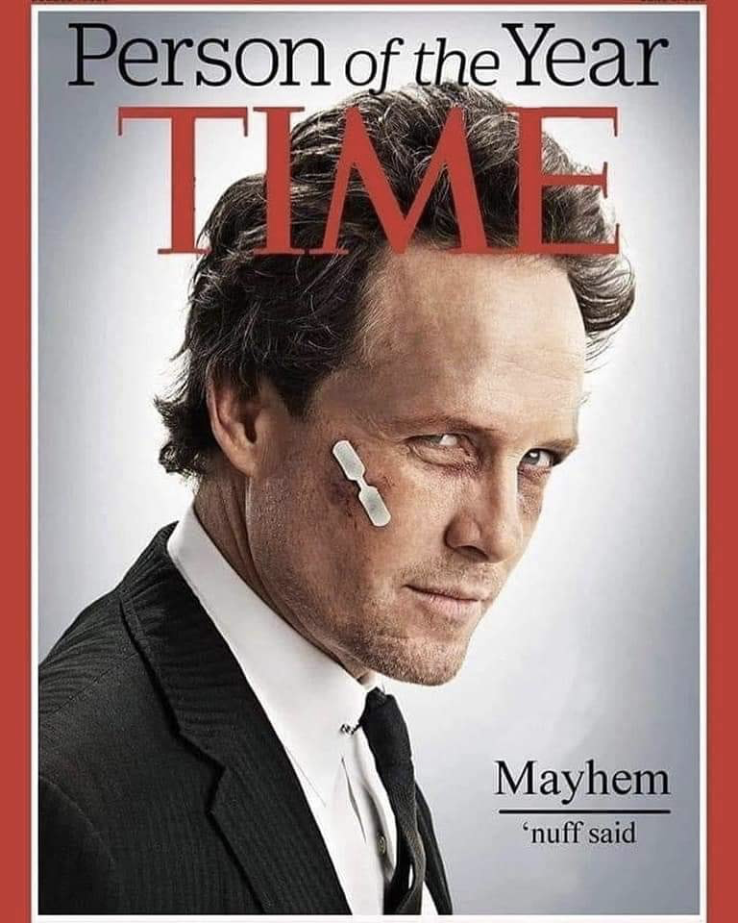
Remote Work?!?
Welcome to 2020!!!
You should be able to adapt… to everything
How do you remote work
Be prepared to be on video
Install video clients before the interview
Make sure you client is installed
Try to use the client
Don’t be shy, but be prepared

Slide 10
Basic Phone screen or first Interview
Almost every “1st” interview is a basic question and answer session.
What is your plan for 5 years
When did you fail
What have you learned from your mistakes
How much money do you want
Can we contact your references
Ability to think on your feet – Not technical
Availability
Two week notice or loose ends that need to be tied up (large projects).
Motivation for this position
Notes:
This is the interview they “feel you out” to see if you want too much money, or if you are really seriously looking. The person doing the interview is most likely not an IT person so try to avoid jargon.

Slide 11
Technical or follow-up
Calm down (remember you’re smart) you made it through one interview
Plan on getting to the interview earlier (10-15 minutes)
If you need caffeine have your normal amount (don’t power bomb 2 Rock Stars to be “on”)
Lets look at some questions:
The list of questions come from SQL Server 2000 and above.
We should all know these questions
We’ve adapted some of the questions for “interview” style but the information is pretty basic
Remember to stay calm, if you don’t know something say so.
Notes:
Calm down.
If you don’t know something, you can say “I think…” or “Is it like…” but don’t try and guess or make up an answer. The people on the other side of the table want to find out how you are going to fit into their environment, if you are guessing or making stuff up will they trust you?

Slide 12
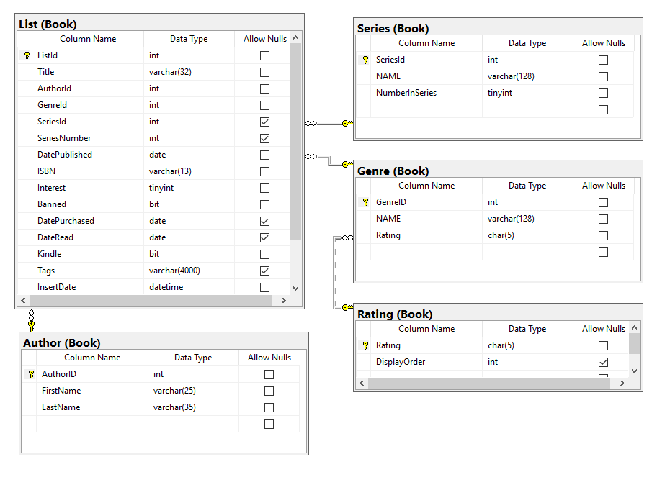
Demonstrate skills
Let see those T-SQL skills with a DEMO.
Notes:
Be ready to let your T-SQL skills shine.
You should be able to express your skills on a computer or white board and you may need to show your design skills by looking at SQL diagrams and understanding most or all of the symbols on the diagram.
DO NOT FREAK OUT.
If you need help or can’t remember something talk it through, ask for help “how would you approach this problem?” can I use google (this could be a yes or no but if you don’t ask you can’t try).
If you use google, know how to google the answer and apply the information to the example needed.

Slide 13
Wrap-up
Why Change
Where to start
Prepare, Prepare, Prepare
Remote Work!?!
I’ll show you how to interview and a few tips and tricks to get over the interview jitters.
Basic – Phone screen
Technical
Demonstrated skills

Slide 14
Session Evaluations
https://www.sqlsaturday.com/997/Sessions/Session-Evaluation
Alternatively go to the Schedule and click on the session you would like to give feedback on and click Session Evaluation

Slide 15
Utah Geek Events slack channels for attendees to chat
To get an invite to the Slack Space
http://bit.ly/2bm3vwW
Channels
#sqlsaturday997_room1
#sqlsaturday997_room2
#sqlsaturday997_room3
#sqlsaturday997_room4

Slide 16
https://github.com/SQLFitness/InterviewingForADBAJob https://www.linkedin.com/in/drblind/ https://twitter.com/SQLFitness

